Slide 1

Turn Up The Data
Anna Chee, Daniel Atuesta, Dan Waehner, Domenic Padulo, Nabila

Slide 2


Background/Motivation
Project Goal
Questions Asked
Dataset
Notes:
Project Goal: To look at how music trends have changed over time and how the variables tracked in the trends effect the popularity of the song.
Questions asked: started off looking to see how covid-19 effected the music industry
Dataset : looked at several apis and csvs with regards to music streaming services

Slide 3
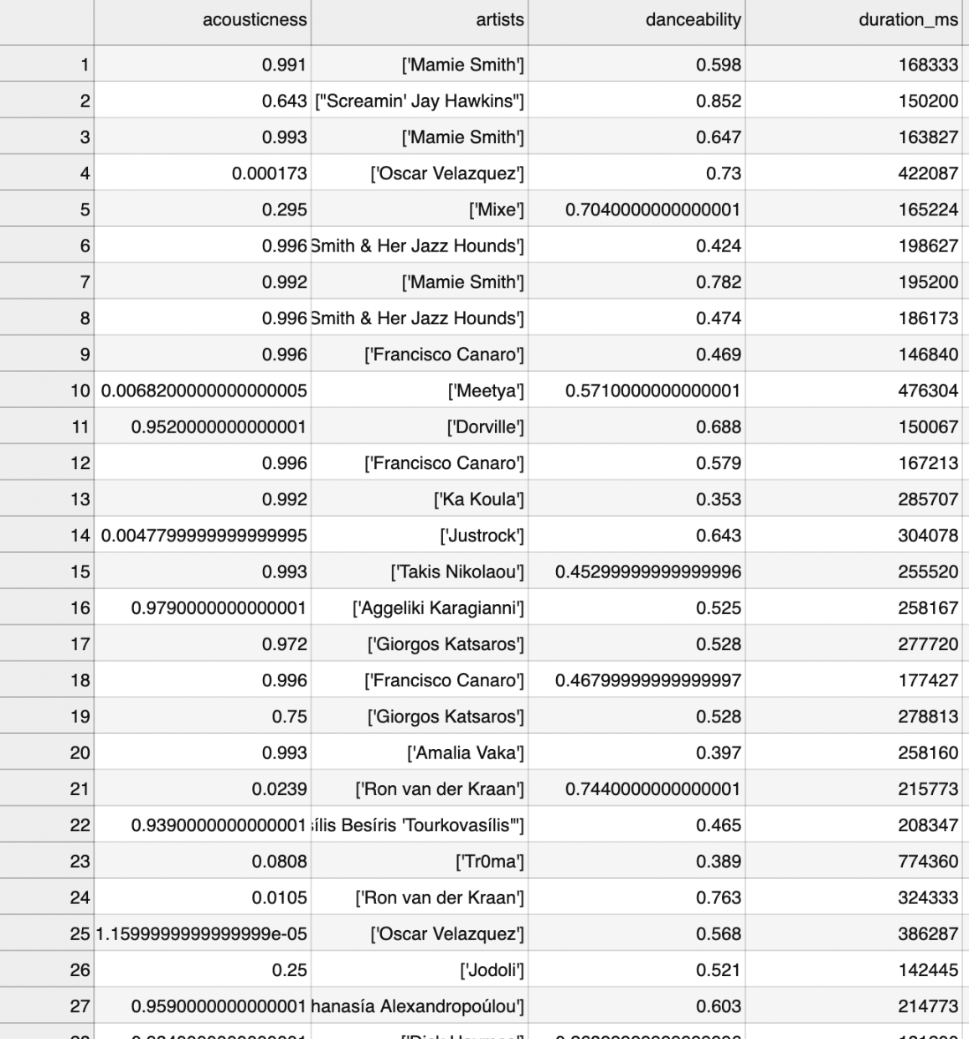
Dataset Background
Dataset Considerations:
Large dataset with tracks from previous years
Music attributes
Popularity metric
Category by genre/artist
Dataset Source:
Spotify Dataset by Yamac Eren Ay
160k+ tracks from 1921-Jan. 2021
CSV files with numerical and categorical data
Notes:
Based on questions we wanted to investigate, had to consider ….
Dataset:
Created by Yamac Eren Ay (pulled from Spotify Web API)
More than 175,000 songs with tracks from 1921 - 2021
Numerical:
accousticness, danceability, energy, duration, instrumentalness, valence, popularity, tempo, liveness, loudness, speechiness, and year
Categorical:
Mode, explicitness, key, artist, song name, and release date

Slide 4
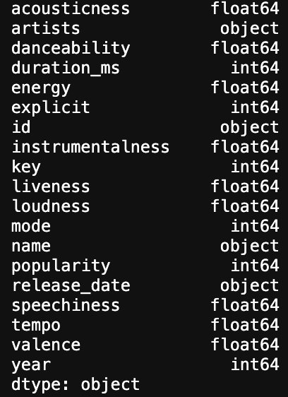
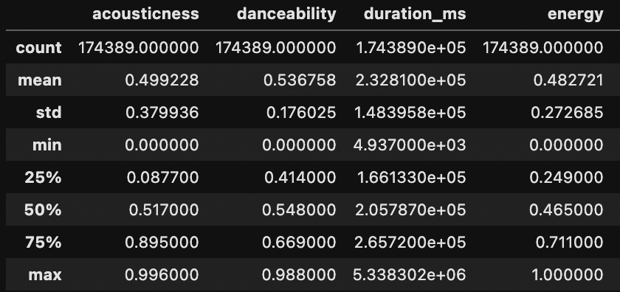
Data Cleanup
Explore Parameters
Choose Sample Size
Dataframe Cleanup
Save to CSV
Notes:
Insights from exploration:
understanding each parameter - Spotify API documentation
3000+ genres with unclean labels
trends of music attributes grouped by year - not too telling as it doesn’t say much about popularity
reduce sample size to most popular tracks only and look at music attribute trends (trend over year and correlation against popularity)
Cleanup:
readability - change duration to minutes instead of ms
convert objects to floats - we want to look at average values per year which cannot be done for object data types
rename column headers based on cleanup
drop any columns that are not needed
once clean, output to separate csv to do analysis

Slide 5
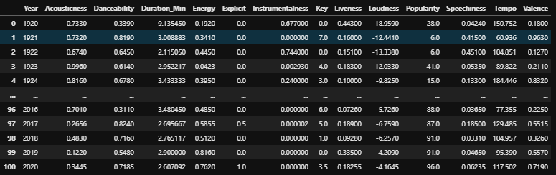
Clean dataframe

Slide 6
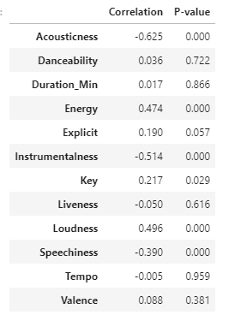
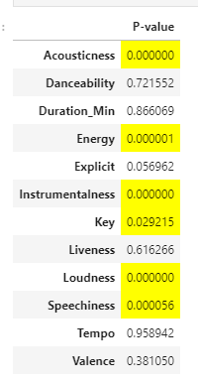
Statistical Analysis
Hypothesis
Null Hypothesis
Pearson’s Correlation Test
Alpha Value = .05
Notes:
•
Hypothesis – There is a relationship between variable x and the popularity of
the song
•
Null hypothesis- There is no relationship between variable x and the songs
popularity
Both variables are numerical we used a Pearson’s Correlation test. We set our Alpha
value to be 0.05

Slide 7
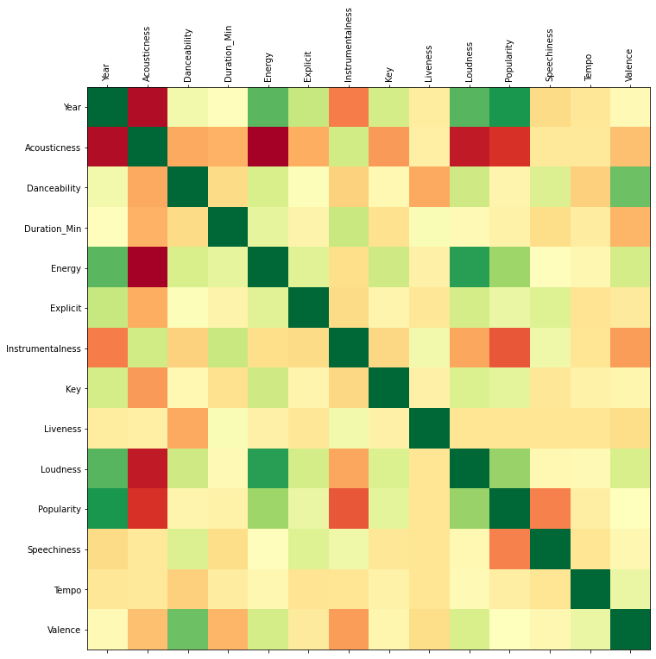
Statistical Analysis
Test independent variables (song components) vs dependent variable (popularity)

Slide 8
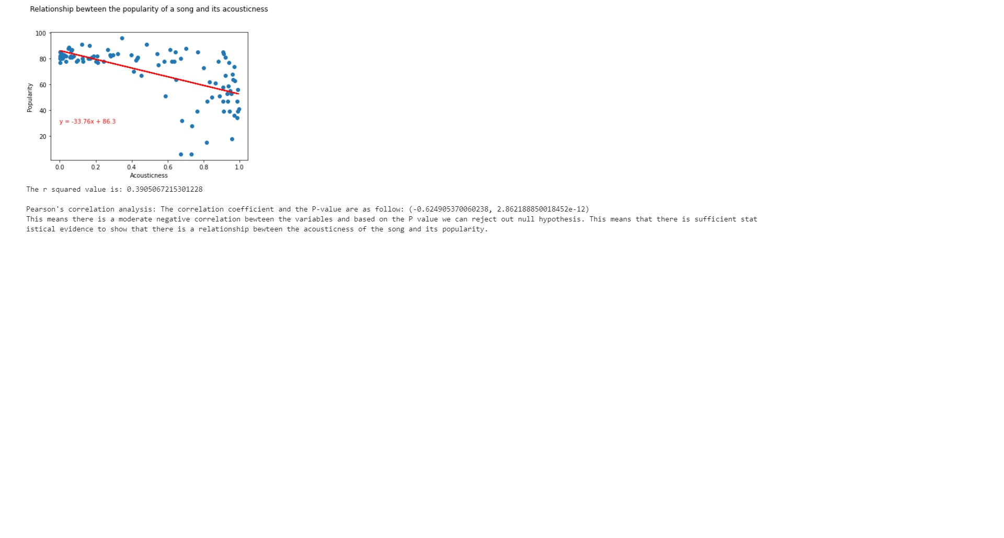
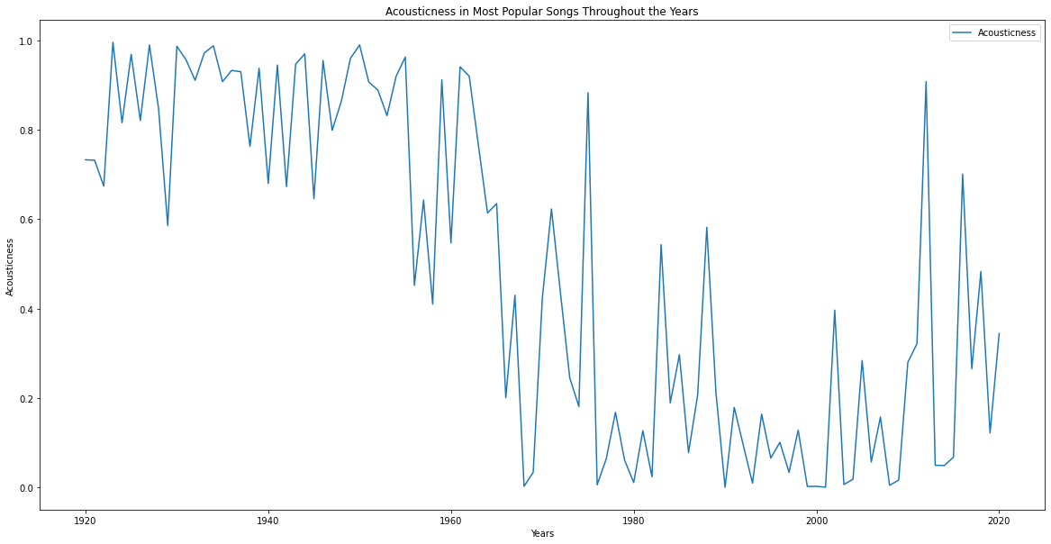
Acousticness
Notes:
##Acousticness
The similarity between the graphs for both most popular and least popular songs by Acousticness speaks towards the decrease in popularity of acoustic instrumentation in contemporary popular music. A far-cry from the audience that sparked a now legendary near-riot when Dylan went electric in 1965 at the Newport Folk Festival, today’s listeners show a clear preference towards songs with electric/electronic instrumentation. Acoustic vs electric/electronic is now more of a matter of choice for musicians, and the meaning of sounds has thus changed over time. To most contemporary listeners, acoustic instrumentation often sets the expectation that a song or album will be of the more introspective singer/songwriter variety (think John Mayer or Sufjan Stevens) and very likely “sad”. With this in mind, it should not come to a surprise that listeners looking to lift their spirits during the Pandemic seem to have been drawn more towards less Acoustic music.

Slide 9
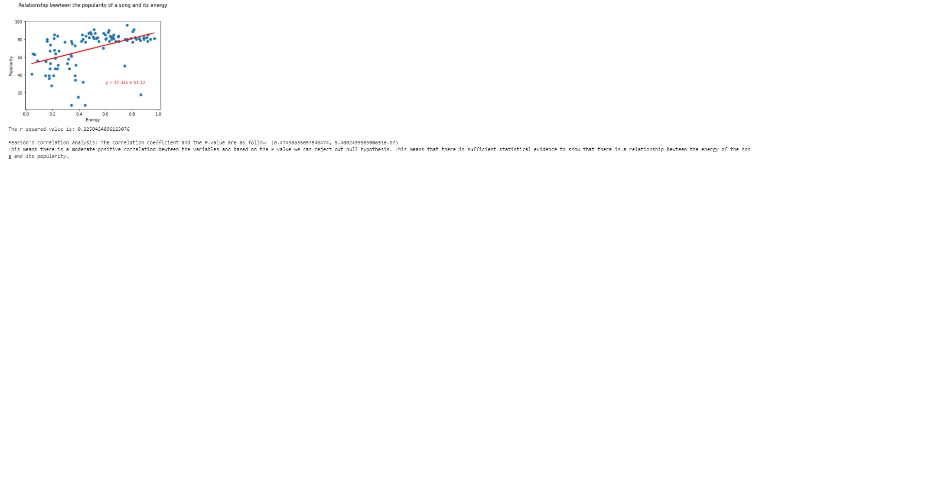
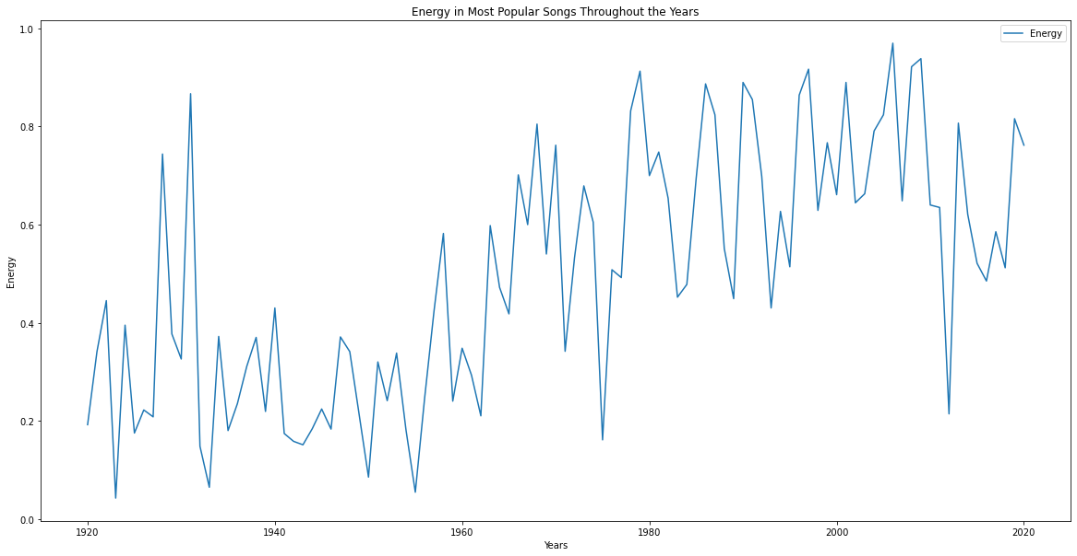
Energy
Notes:
##Energy
Popular music has become more energetic as time has gone on. This increase very likely has more to do with the capabilities and innovation of modern instruments. Electric and electronic instrumentation have allowed artists to exponentially increase the energy, and listeners and dance floors have been eager to keep up.
​

Slide 10
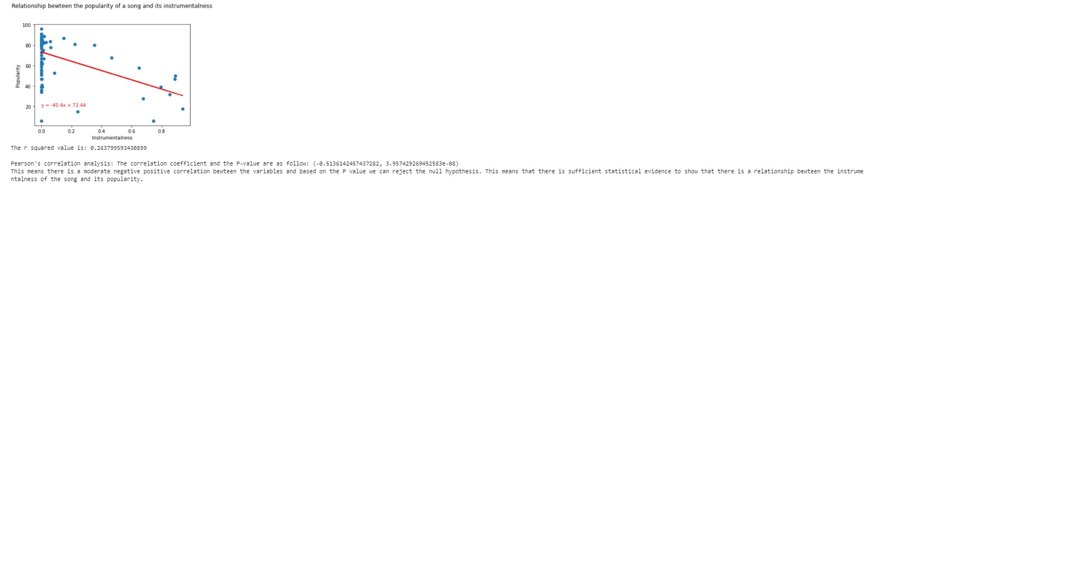
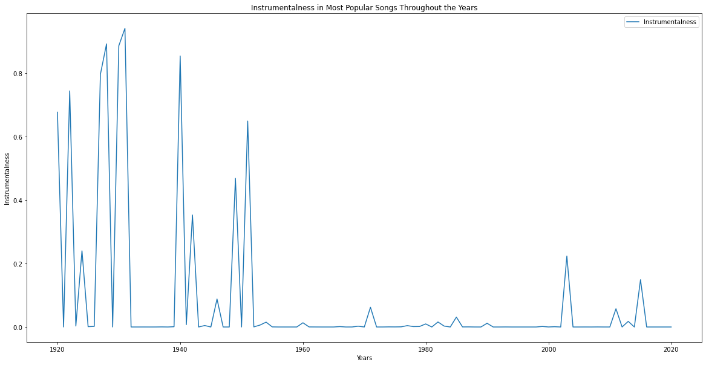

Instrumentalness
Notes:
##Instrumentalness
As improvements in recording technology made it easier for artists to mix vocal tracks into their recordings, listeners have essentially never looked back. By 1960, songs without vocals nearly flatline in popularity. The only significant outlier is the sudden increase just after the year 2000 on the graph. This can almost certainly be attributed to Daft Punk’s Electronic Dance Music album *Discovery*, which was released to enormous popularity in 2001 and spawned countless imitators while blurring the already fuzzy lines between rock music and dance music.

Slide 11
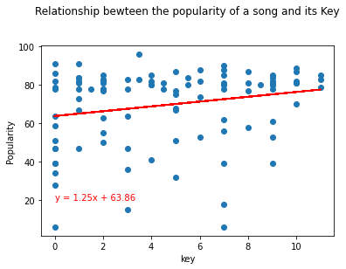
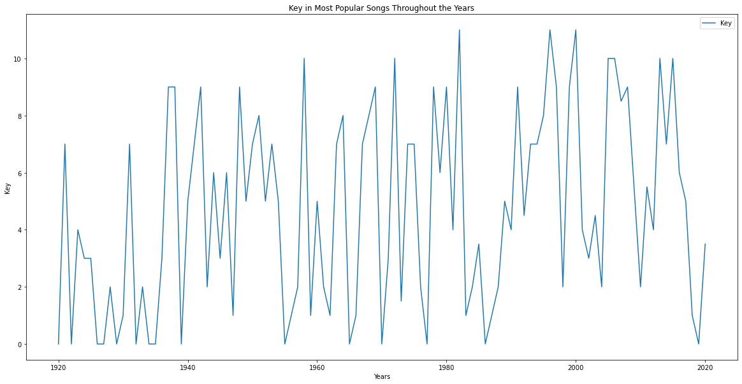
Key
Notes:
for key (at least from the value counts we pulled), it seems like keys of C and G are the most frequently occurring among the most popular tracks, which makes sense given that they are the two most standard keys to play in (for instruments)
6:04
and a popular range for vocalists
6:05
^just FYI

Slide 12
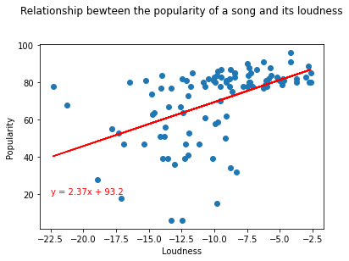
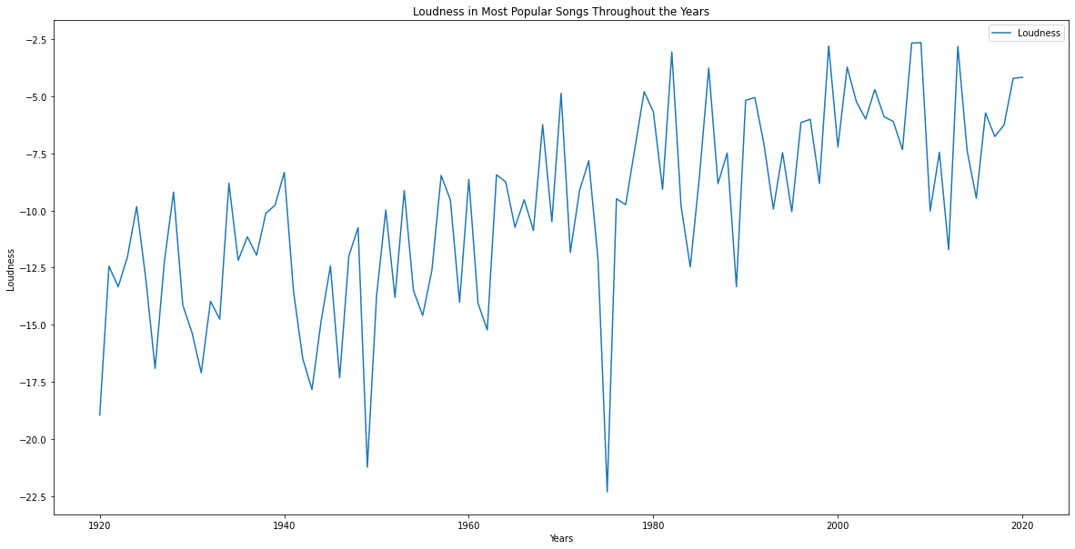
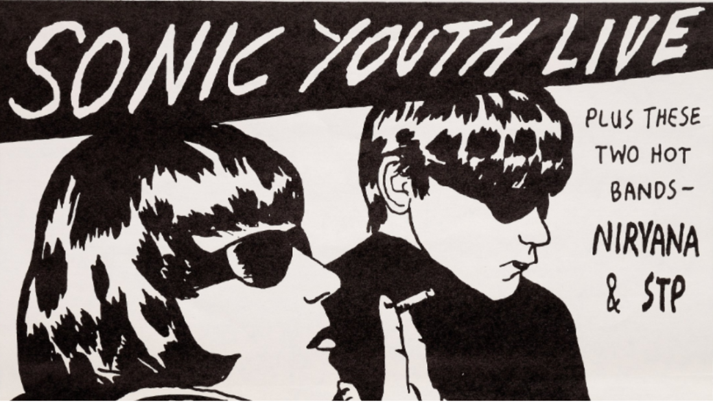
Loudness
Notes:
##Loudness
Louder songs tend to be more popular than their quiet competition. As improvements in recording technology have allowed music to be recorded and played at higher volumes before they begin to distort, popular artists have been happy to turn it up. Louder songs are more likely to grab a listener’s attention on the radio, a personalized “Release Radar” playlist or even a television commercial.

Slide 13
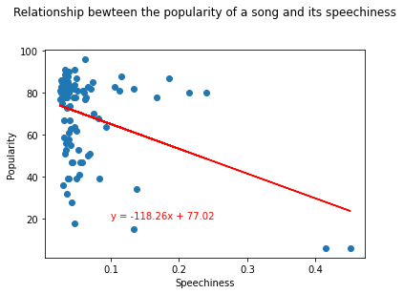
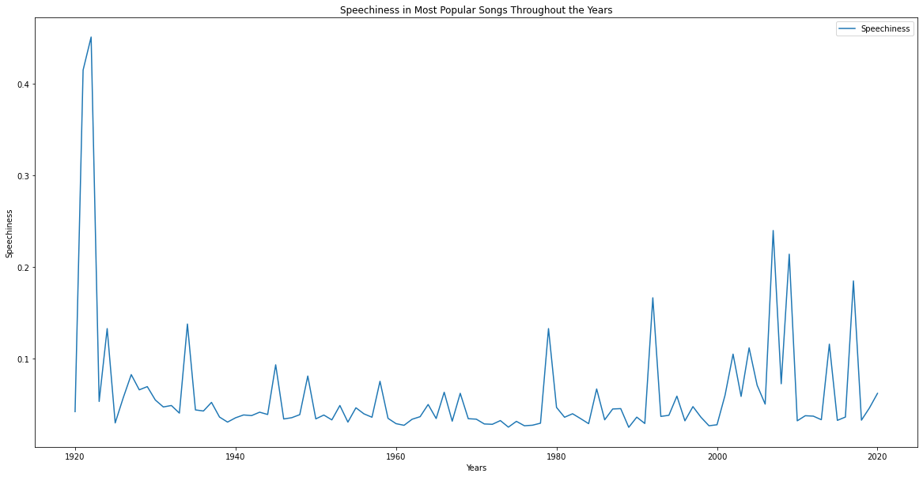
Speechiness
Notes:
##Speechiness
Songs and tracks with higher levels of speechiness are quite simply not popular. As soon as tracks incorporate more than a just a few lines of spoken (as opposed to sung) vocals, they sacrifice whatever chance they had at popularity.

Slide 14
Summary
To create a song that fits current popularity trends we recommend:
Energy | Acousticness | Instrumentalness | Key | Loudness | Speechiness
0.5 | 0.5 | .1 | C (Value of 0 in dataset) | -9.9 | 0.1

Slide 15
Post Mortem
Problem solving along the way
Data limitations
Expanded research possibilities
Notes:
Problem solving along the way:
Our approach was to split up the work load and really dive into the material individually that they had chosen or been assigned.
When people got stuck we were able to come together as a team and look through to see if we needed to adjust code, attack the data in a different way, or change the question being asked to something plausible
By approaching problems this way we were able to leverage all of our strengths into a cohesive unit and kept progress moving
Data limitations:
Popularity is skewed to reflect current values rather than over time
Limited music listeners
Limited artists rights/songs
Expanded research possibilities
Taking the time periods leading up to and immediately following major world events to see how music was altered
Or doing the same thing but with specific influential artists ie.- beatles, NWA, Elvis,
Take our approach from a decade by decade approach
Assign value ranges for genres to consolidate the genre list that is present in this dataset

Slide 16
Q&A

